Slide 1

AI in Automobile Industry
By - Priya Sarkar

Slide 2

My Background
B.Tech from IIT Bombay
Worked with HDFC Developers as a Data Scientist
Worked with JP Morgan and Chase as a Data Scientist
Working as a Deputy Manager with Deloitte in the CX team
Currently a part of Digital Product School, UnternehmerTUM
Connect me at sarkar.priya.iitb@gmail.com and https://www.linkedin.com/in/priya-sarkar/
Read about my blogs at https://medium.com/@divalicious.priya

Slide 3
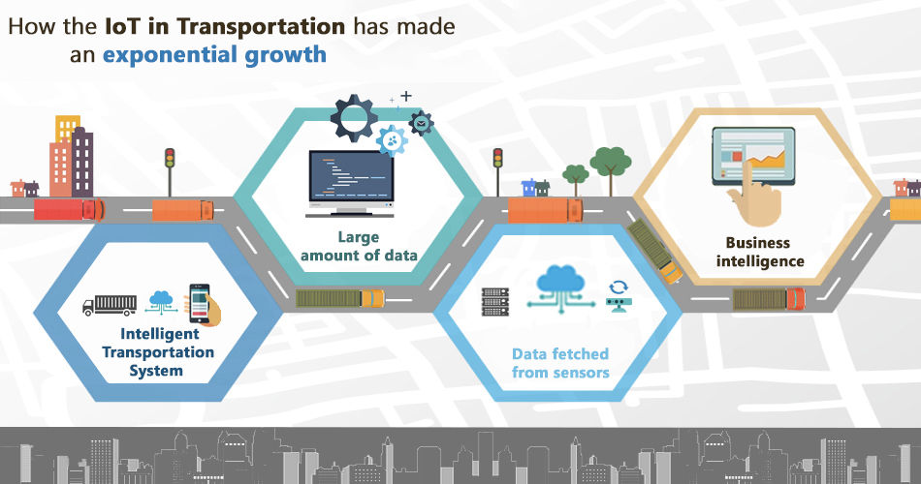

AI in Transportation

Slide 4




It has stated that automotive industry will be the second largest producer of data in the forthcoming years and if we combine automotive with travel and logistics industry then the output for the same grow by an additional 30%.
Large automotive OEMs can boost their operating profits by up to 16% by deploying AI at scale across supply chain operations and production centers.
Cars are no longer merely the means of getting from point A to point B, nor are they simply status symbols, instead they have become functional assets. Particularly in recent years car manufacturers have discovered growing customer demands for digital infotainment solutions and other in-car services

Slide 5
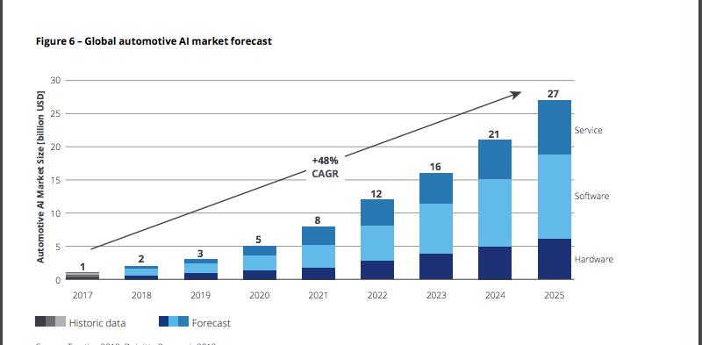
LINK TO REPORT BY TRACTICA

Slide 6
Connected Cars
HYUNDAI’s version of connected cars
Nissan’s version of concept cars

Slide 7
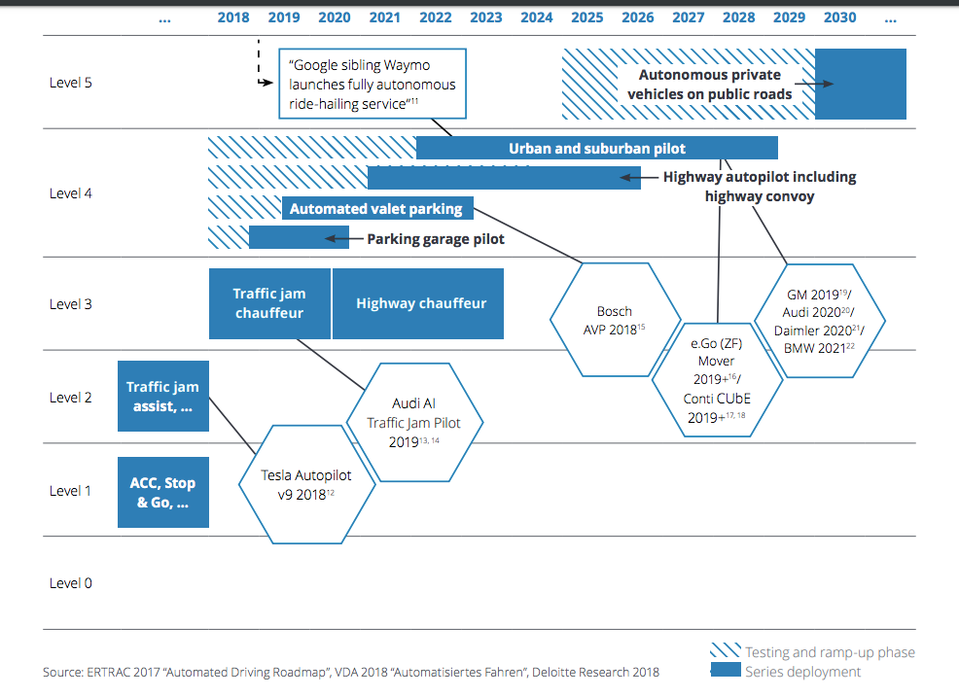
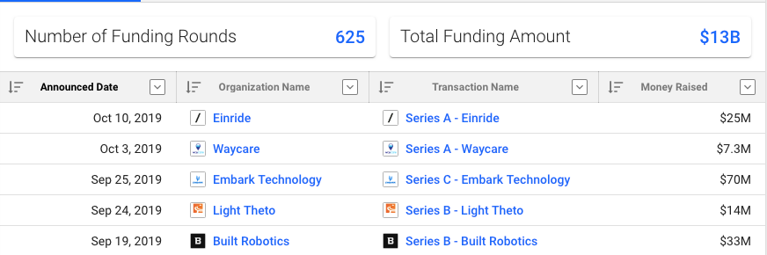
Autonomous Cars a myth no more

Slide 8
Innovation at BMW
Life at BMW

Slide 9

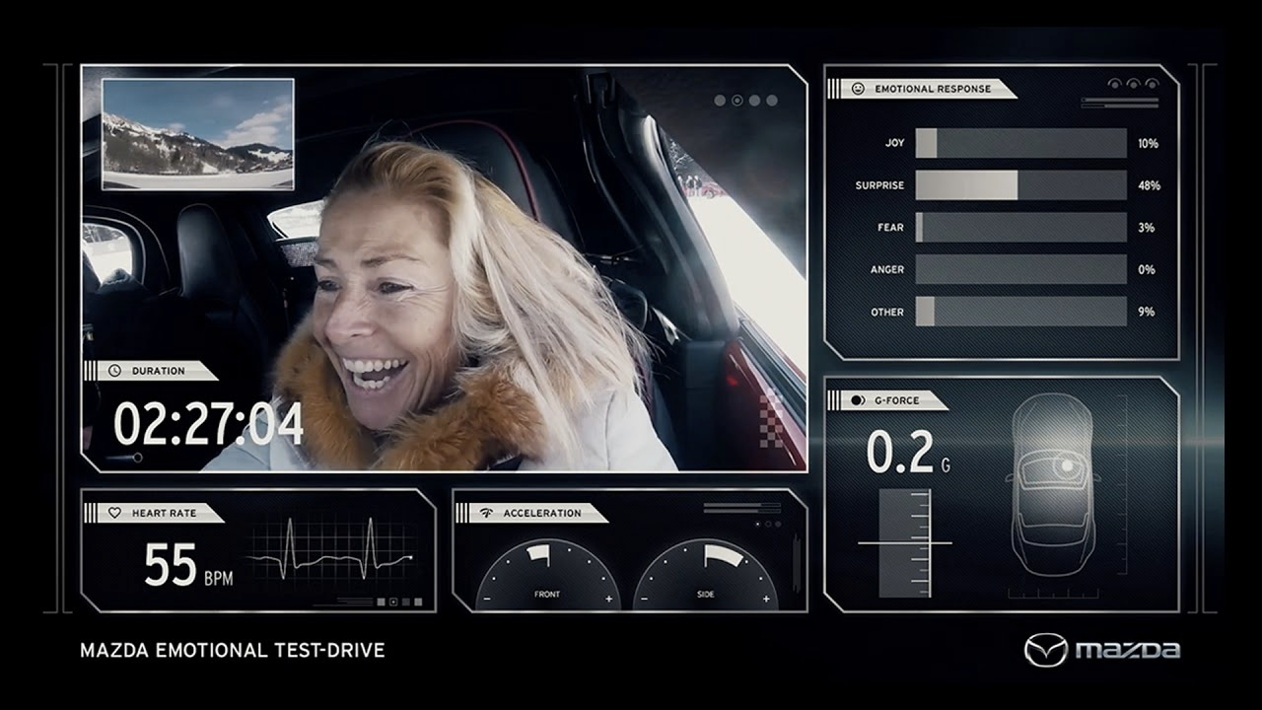
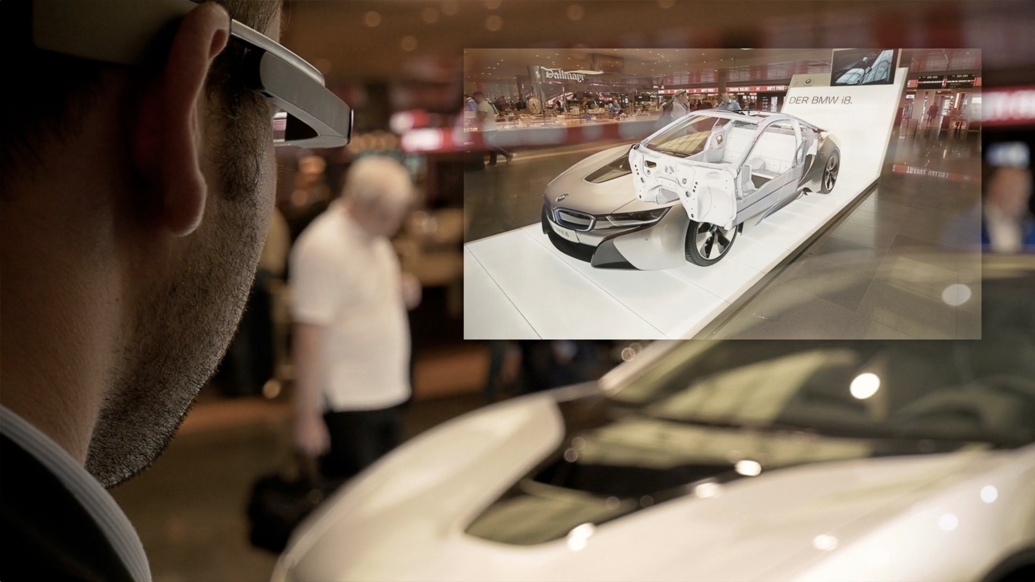
AI to help customer experience
BMW Glass
Predictive Maintenance
Mazda Emotional Drive on Ice
BMW uses Google Glass at it’s launch event of I8 which uses Augmented Reality enhance user experience.
BMW’s TSARAVision Smart Glasses, can help technicians put technical drawings right in front of a tech’s eyes.
Click here
AI can help you collect telemetry data from the users car and predict break down or schedule the next maintenance visit to the repair shop.
This data can also segment customers on their driving pattern to send them recommendations
Click here
Mazda conducted an experiment along with University of Fribourg and 60 lucky participants, ventured into the cold, and used facial expression analysis and galvanic skin response to investigate driver engagement for gauging customer experience
Click here

Slide 10
“AI is everywhere. It's not that big, scary thing in the future. AI is here with us.”
–Fei-Fei Li

